Slide 1
Crimes in San Francisco
The A Team

Slide 2
Project Scope
After much delibration and starting on many project we finally settled with an evaluation of the number of crimes in San Francisco City.
We got the data from DATASF website. However, instead of using the API we used the CSV because the API would only give us access to 1000 data points while the csv gave us access to 154,916 data points.

Slide 3
Our Objective is to increase awareness About the number of Crimes in San Francisco City

Slide 4
Daily 425 Crimes are Reported on Average

Slide 5
We have explored some of the following questions regarding Crimes in San Francisco
Which neighborhoods are the most dangerous and which ones the safest?
Which police district is the busiest? (where do most of the crimes happen)
What days of the week and what times most of the crimes take place?
What type of crimes are most likely to happen in any given day in a week?
Which Bart Stations at the cradle of crime?
What is the best and worst days to visit San Francisco?

Slide 6
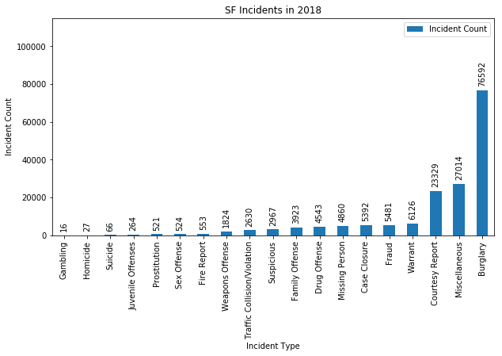
What is the most common crime?

Slide 7
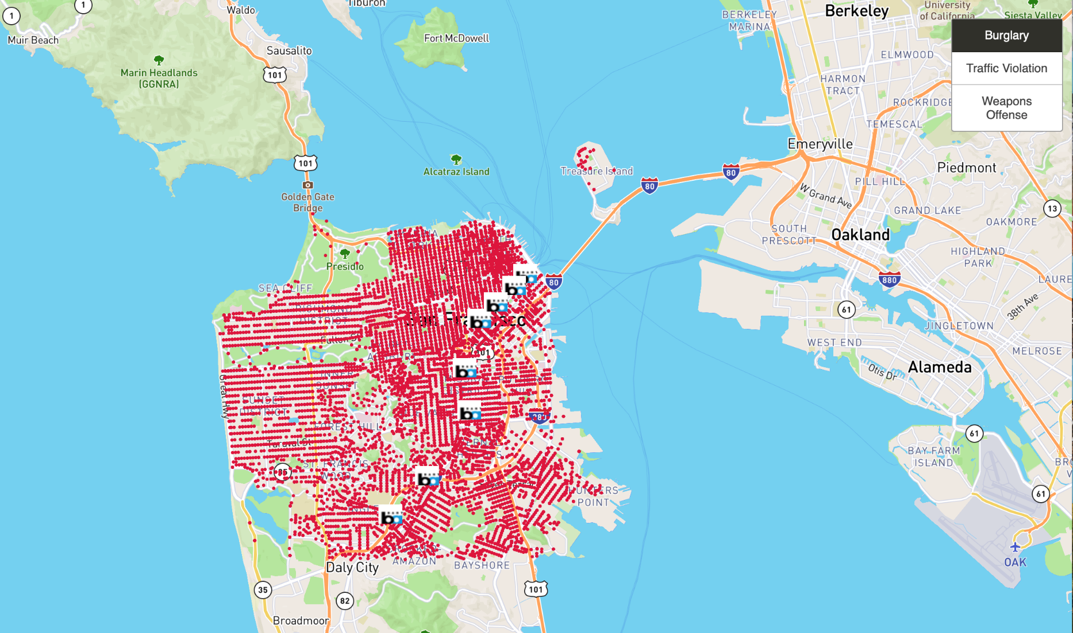
Which Bart Stations at the cradle of crime?

Slide 8
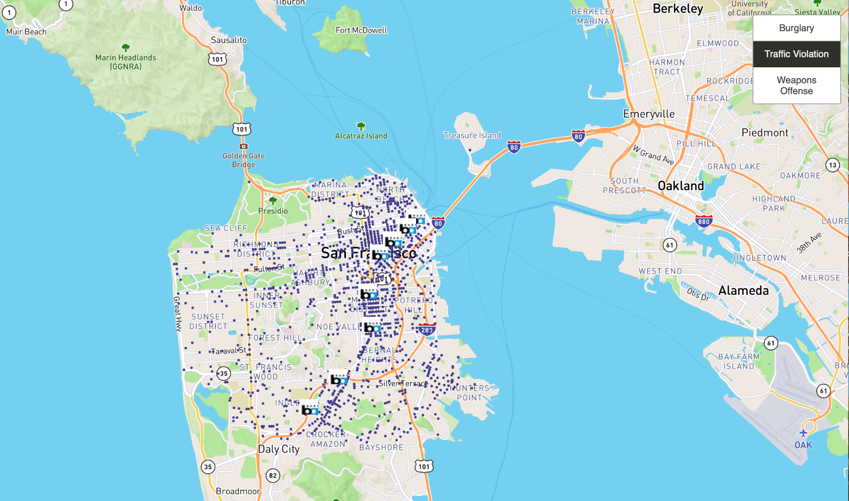
If you are driving be ware that most of the traffic violations happen in the Mission District

Slide 9
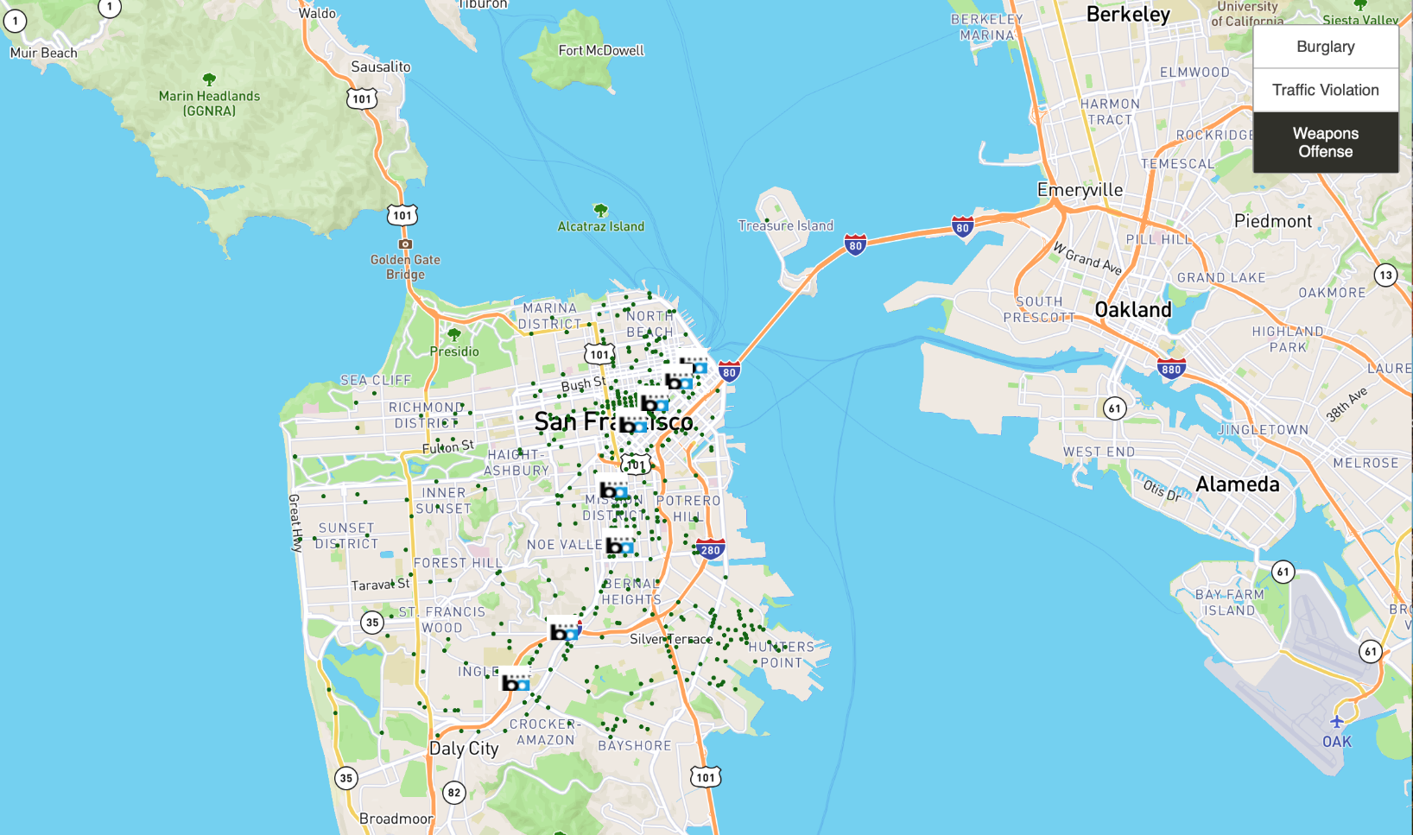
If you are taking the bart, stations between civic center and Powell street are the most dangerous in terms of weapon offense

Slide 10
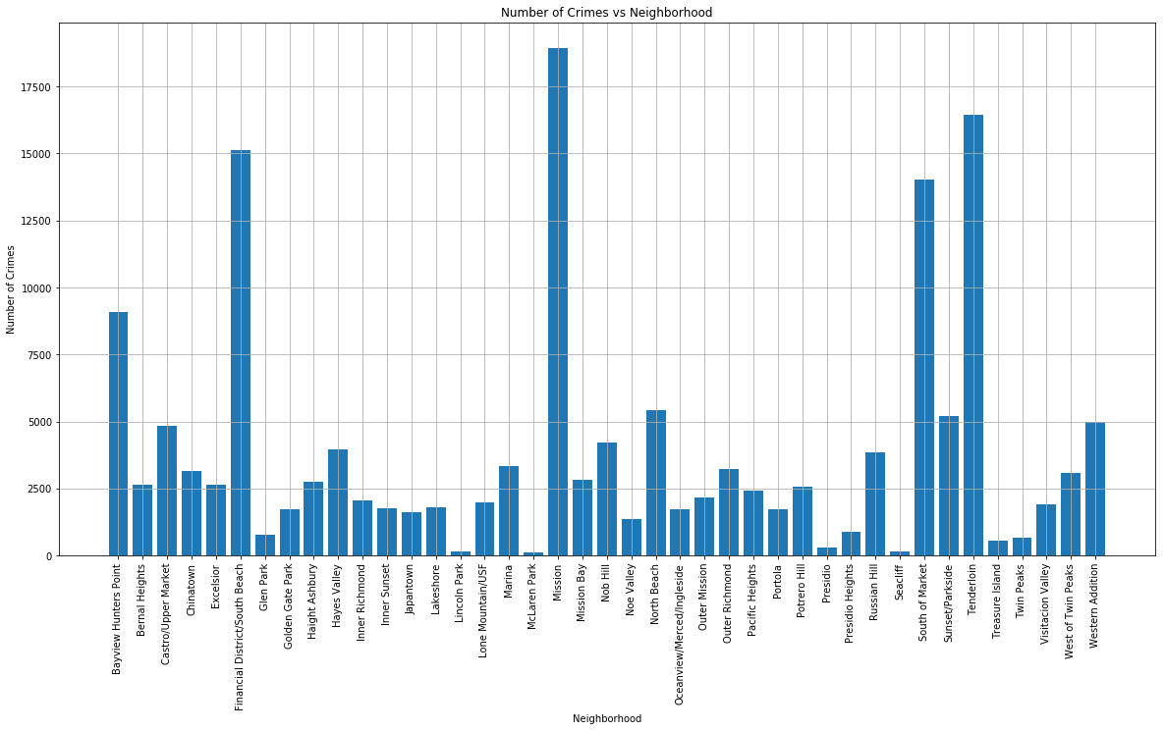
Which neighborhoods are the most dangerous and which ones the safest?

Slide 11
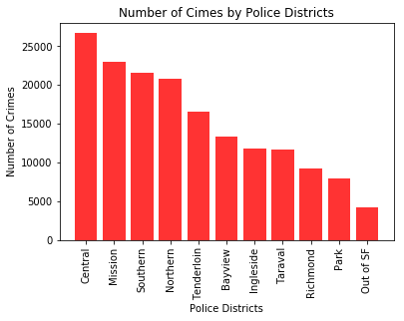
Which police district is the busiest? (where do most of the crimes happen)

Slide 12
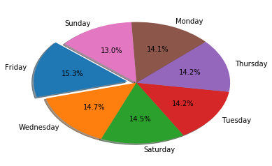
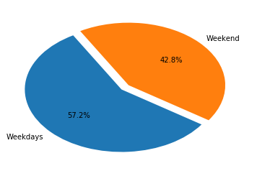
What days of the week and what times most of the crimes take place?

Slide 13
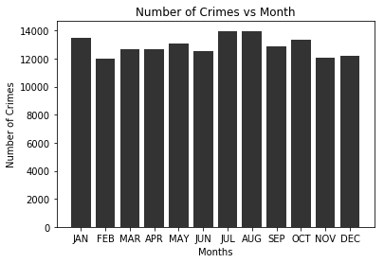
Number of Crimes is at its peak in the months of July, and August, followed by January and October.

Slide 14
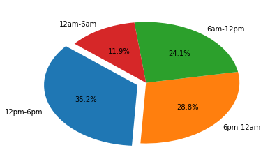
Type of Crime in Any Given day

Slide 15
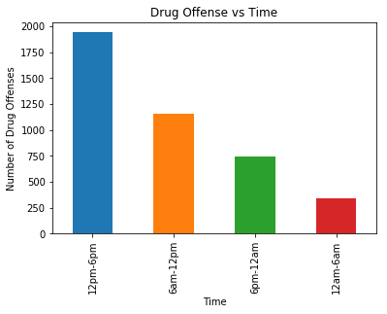
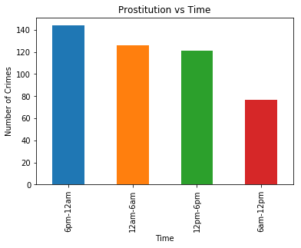
Type of Crime in Any Given day

Slide 16
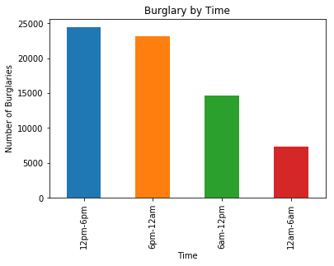
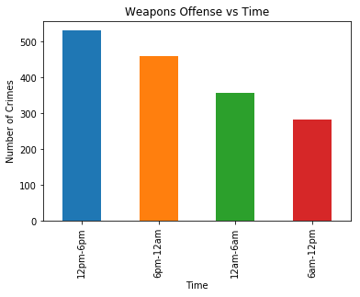
Type of Crime in Any Given day

Slide 17
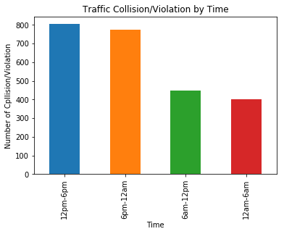
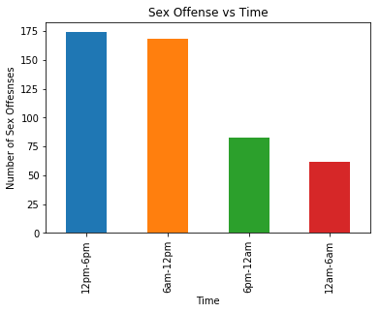
Type of Crime in Any Given day

Slide 18
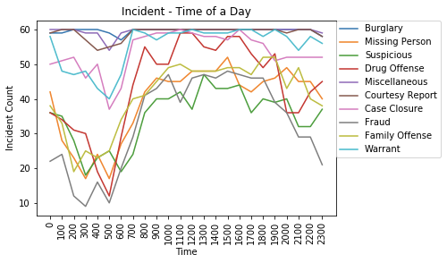
Type of Crime in Any Given day

Slide 19
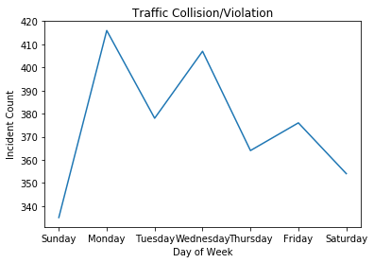
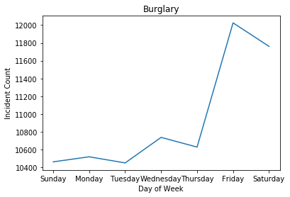
Type of Crime in Any Given day of the week

Slide 20
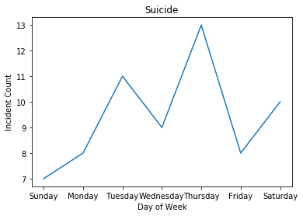
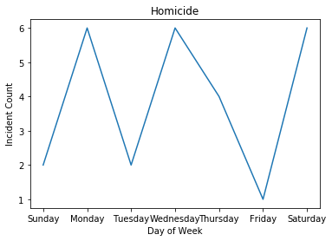
Type of Crime in Any Given day of the week

Slide 21
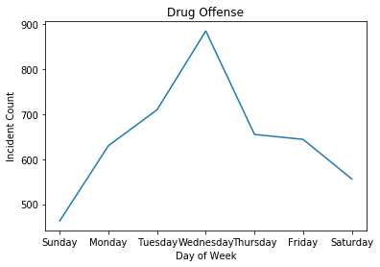
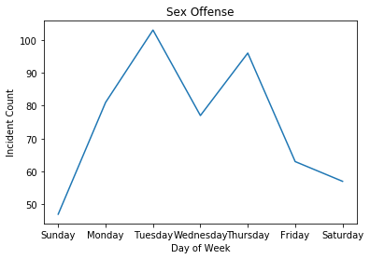
Type of Crime in Any Given day of the week

Slide 22
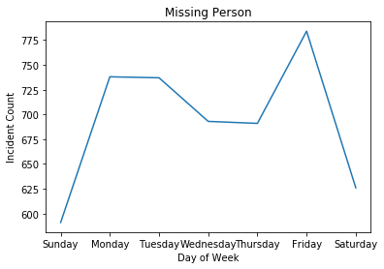
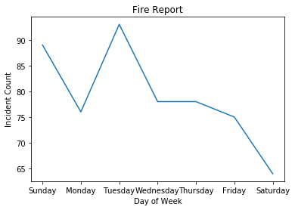
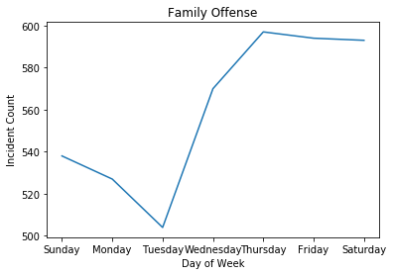
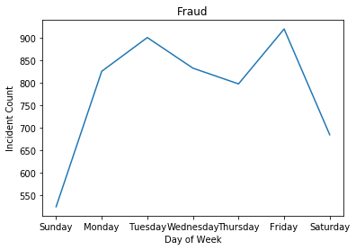
Type of Crime in Any Given day of the week

Slide 23
What is the best and worst days to visit San Francisco?
The best day of the week to visit San Francisco is Sunday and the worst day is Friday.

Slide 24
Thank You ☺

